Slide 1
NE 763: Advanced Reactor Materials
Fall 2026
Dr. Benjamin Beeler

Slide 2
Last Time
TRISO particle intro, evolution into current TRISO design
Different layers and their roles
kernel, buffer, IPyC, SiC, OPyC
Fuel kernel – UO2 and UCO
UO2 retains fission products, but generates CO
UC2 limits CO formation, but poorly retains fission products
Fission products
Oxygen potential controls which compounds form, transitioning UC into UO2, while some FPs form oxides and other carbides
SiC
introduced structure and started discussing radiation effects

Slide 3
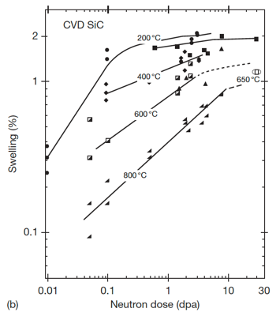
Low-Med T Radiation Effects in SiC
Above the critical amorphization temperature (423 K), the swelling increases logarithmically with dose until it reaches saturation
The saturation level decreases with increasing irradiation temperature
The dose exponents of swelling during the log period are often close to 2/3, in line with assumptions based on interstitial clusters
This temperature regime is referred to as the point-defect swelling regime and goes from critical amorphization temperature to about 1273 K
Tirr=300 C, 6 dpa
Dot number density 2.2e+24m-3
Mean dot diameter=1nm
Tirr= 800 C, 7.7 dpa
Loop number density 3.3e+23m-3
Mean loop diameter = 3.0 nm

Slide 4

Saturation Swelling in SiC
Log swelling vs dose shown at right for CVD SiC irradiated in HFIR
The swelling of SiC is highly temperature dependent
at 1 dpa, saturation values from 200 C to 800 C vary by a factor of 5
The decrease in saturation with increasing T is due to increased recombination of defects
Swelling saturates at relatively low doses, less than 10 dpa

Slide 5
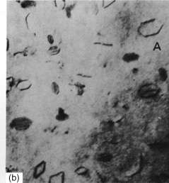
High T Radiation Effects in SiC
Above 1000C, Frank loops of the interstitial type become the dominant defects observed by TEM
Interstitial Frank loops are faulted, in that they include a stacking fault
Consequently, these loops cannot glide and will not move under an applied stress or temperature, and are therefore considered as sessile
At high temperature, the development of Frank loops into dislocation networks through unfaulting reactions at high doses is reported
Frank loops in Al

Slide 6
High T Radiation Effects in SiC
The volume associated with dislocation loops in irradiated SiC has been estimated to be on the order of 0.1%
At high T (greater than about 1250 K) vacancies are sufficiently mobile and vacancy clusters can be formed
This high T regime is the void swelling regime
1130 C, 1.8 dpa
1130 C, 8.5 dpa
1280 C, 5.0 dpa
1450 C, 1.8 dpa
1450 C, 5.0 dpa
1450 C, 8.5 dpa
Evolution of voids in high-temperature irradiated CVD SiC

Slide 7
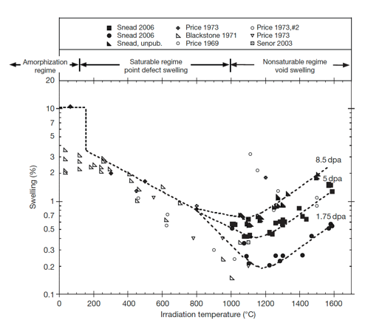
Irradiation-Induced Swelling in SiC
The transition from point-defect saturated swelling to void swelling occurs above 1000C
Void swelling increases as a function of dose, and is not known to saturate
The swelling near the critical amorphization temperature is described as the differential strain between point defects or small defect clusters

Slide 8
Irradiation-Induced Swelling in SiC
Above the critical amorphization temperature, the number of defects surviving recombination is reduced and the mobility of both silicon and carbon interstitials becomes significant
Above 1000 C microstructural studies have noted the presence of both Frank loops and tiny voids, indicating limited mobility of vacancies
The max irradiation temperature shown is 0.65 T_{melt}

Slide 9
Irradiation-Induced Swelling in SiC
In typical fcc metal systems void swelling typically begins at ~0.35Tm, goes through a maximum value, and decreases to nil swelling by ~0.55Tm
The voids in SiC are continuing to grow in SiC irradiated to 1773 K, thus the energies for diffusion of either the Si or C vacancy or both must be quite high
This has been confirmed through DFT methods
It is unclear how swelling will increase as a function of dose above 10 dpa

Slide 10
Recap of SiC Irradiation Defects
below 423 K, SiC can amorphize, can have fairly high swelling rates
at 423-1273 K, point defect swelling regime
black spot defects are the main types of defects
cause swelling which saturates, the level of which is inversely proportional to T
above 1273 K, we get Frank loops and voids
void swelling regime
does not saturate, increases with dose and with T

Slide 11
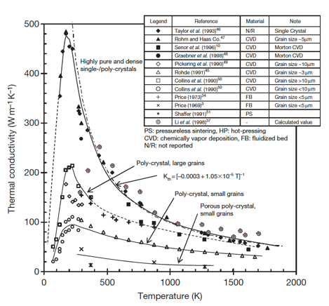
Thermal Conductivity Degradation
SiC is a ceramic with a band gap, and thus thermal conductivity is based on phonons
The conduction of heat can be generally described by the strength of the individual contributors to phonon scattering: grain boundary scattering; phonon–phonon interaction; and defect scattering
Each of these types occurs at differing phonon frequencies and can be considered separable

Slide 12
Thermal Conductivity Degradation
The unirradiated k_{th} is highly dependent upon initial microstructure and temperature
Initial microstructure can be tailored, but the temperature dependence cannot be removed
For reference, Zr thermal conductivity is about 22 W/m-K at 1000 K

Slide 13
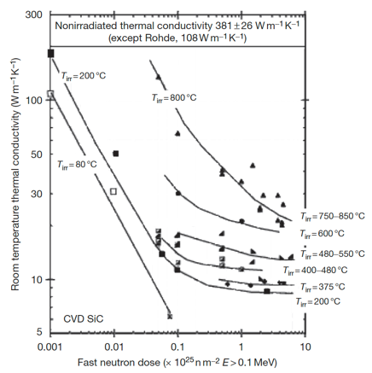
Thermal Conductivity Degradation
At low temperatures irradiation produces simple defects and defect clusters that very effectively scatter phonons
In this case, defect scattering quickly dominates, with saturation thermal conductivity typically achieved by a few dpa
Defect scattering is sufficiently present to eliminate the typical temperature dependence

Slide 14
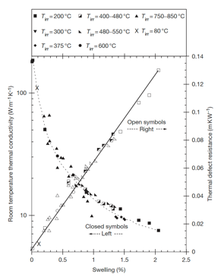
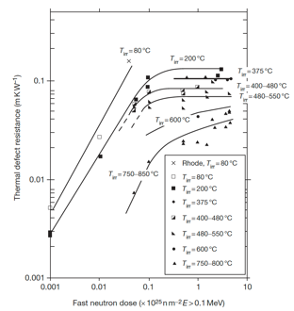
Thermal Conductivity Degradation
The thermal defect resistance is defined as the difference between the reciprocals of the irradiated and nonirradiated thermal conductivity (1/K_{rd} = 1/K_{irr} – 1/K_{nonirr})
This term can be related directly to the defect type and concentration present in irradiated ceramics
The thermal defect resistance is directly proportional to the irradiation-induced swelling in SiC
This allows an indirect determination of thermal conductivity by measurement of the density change in the TRISO SiC shell

Slide 15
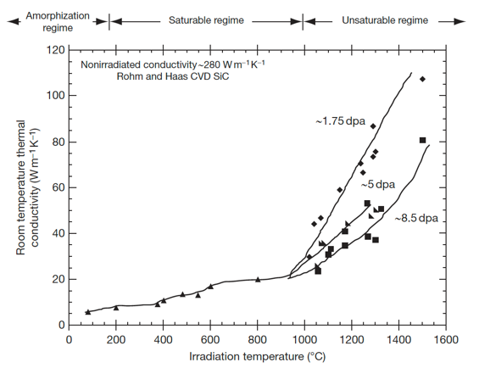
Thermal Conductivity Degradation
In the high temperature void swelling regime, thermal conductivity degradation is not expected to saturate, as voids continue to grow and scatter phonons
Additionally, the linear relationship between swelling and thermal defect resistance does not exist at high temperature
Generally, void swelling does not degrade thermal conductivity as severely as point defects, but data at high T is quite limited

Slide 16
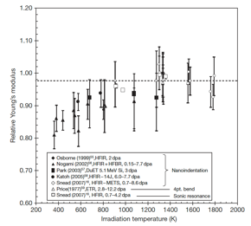
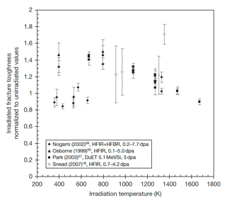
SiC Mechanical Properties
Irradiation generally reduces modulus to a greater extent for lower temperature irradiation, while the modulus reduction becomes negligible when irradiation temperature reaches or exceeds 1273 K
Irradiation-induced toughening (increase in fracture toughness) seems to be significant at 573–1273K in spite of the decrease in elastic modulus
However, there is significant scatter in the data
Reminder: toughness is related to the area under the stress–strain curve

Slide 17
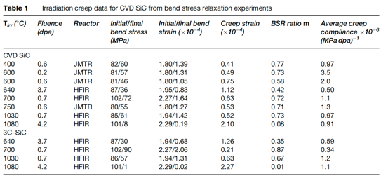
SiC Creep
Irradiation creep is defined as the difference in dimensional changes between a stressed and an unstressed sample irradiated under identical conditions
Studies on irradiation creep of SiC have been limited, although it is of high importance for SiC in TRISO particles
The creep strain for CVD SiC exhibited a weak temperature dependence at <0.7 dpa whereas a major transition at higher doses likely exists at higher temperatures

Slide 18
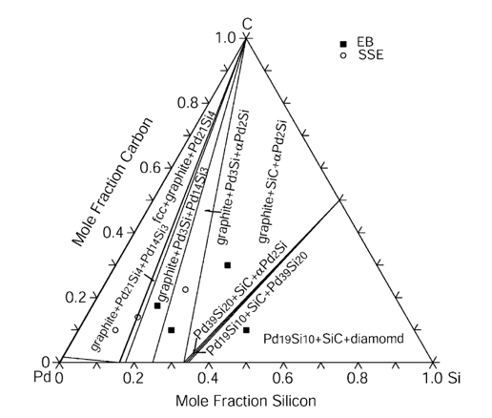
SiC Corrosion
The silicon carbide layer serves as a critical fission product barrier, but can be corroded by fission products, in particular palladium
Additionally, silver can be transported through intact SiC layers
For Pd, the reaction with SiC can be qualitatively explained by the phase-diagram, where a number of intermetallic structures are present
To prevent corrosion by Pd, new combinations of coating layers have been proposed, and means of trapping Pd in the fuel are explored

Slide 19
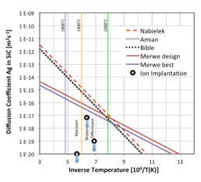
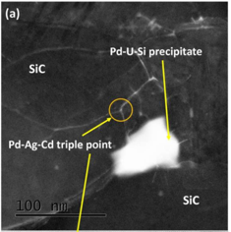
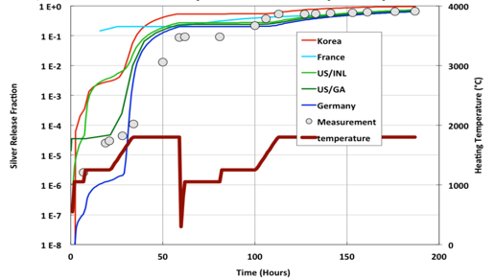
SiC Corrosion
Silver release has been observed from undamaged particles suggesting that Ag migrates through intact SiC layers at temperatures >1100 C
The Ag migration mechanism remains not fully understood, but has a temperature dependence, and is expected to be grain boundary diffusion driven
From microstructural analyses, it seems possible that Ag, Cd, and Pd cluster and transport together at grain boundaries and triple points because of their common chemical properties

Slide 20
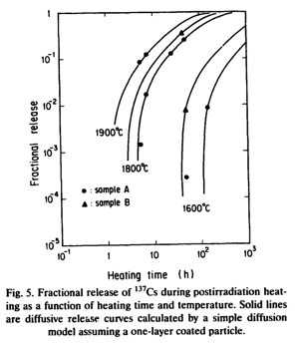
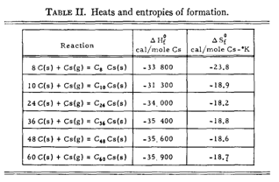
SiC Corrosion
Once cesium has migrated into the buffer, it can react with carbon
At nominal temperatures, cesium may be released from the fuel and associate with carbon of the buffer layer to form compounds
These compounds can vaporize, and may become a potential source of cesium release
Typically, cesium-graphite compounds are not stable at 923 K under vacuum and decompose to give cesium vapor and graphite

Slide 21
Wrap-Up on SiC
SiC: high strength, high thermal conductivity, high temperature stability, oxidation resistant
Radiation damage is dependent on temperature/fluence
Radiation induced swelling corresponds to defect types
In point defect swelling regime, thermal conductivity directly corresponds to defect concentration
Mechanical properties largely unaffected by irradiation
Reasonably good creep resistance, more susceptible to irradiation creep at high T
Pd attack is a key concern, with Pd-Si compounds consuming the SiC layer
Ag release can occur in intact particles, probably via GB diffusion

Slide 22
Graphite

Slide 23
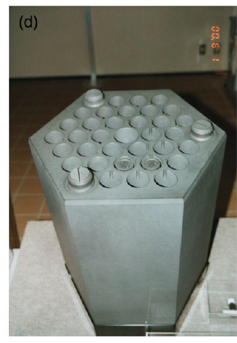
Graphite Usage
Graphite was the moderator in the first reactor to sustain a chain reaction and has been used as a moderator in over 100 nuclear reactors, many of which are still operating
Graphite has a high neutron scattering cross-section and a very low neutron absorption cross-section, making it an ideal moderator

Slide 24
Delineate Types of Graphite
TRISO Graphite (PyC)
CVD deposition
treated to ensure ultra dense and high purity
Prismatic Blocks and Pebbles
large scale
different fabrication process from TRISO
different microstructure
We will generally be talking about large scale graphite, which most directly applies to prismatic block type graphite
Similar radiation effects are assumed to occur in PyC layers
Not sufficient research into potential differences in PyC vs bulk graphite behavior

Slide 25
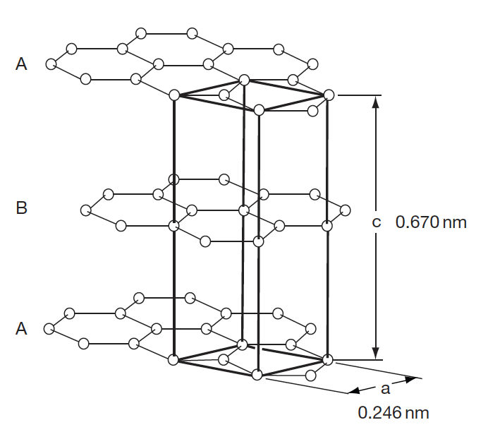
Graphite Structure
The electronic hybridization of carbon atoms (1s2, 2s2, 2p2) allows several types of covalent-bonded structures
In graphite, we have sp2 hybridization where the carbon atom is bound to three equidistant nearest neighbors in a given plane to form the hexagonal graphene structure
The sheets are weakly bound with van der Waals type bonds in an ABAB stacking sequence with a separation of 0.335 nm

Slide 26
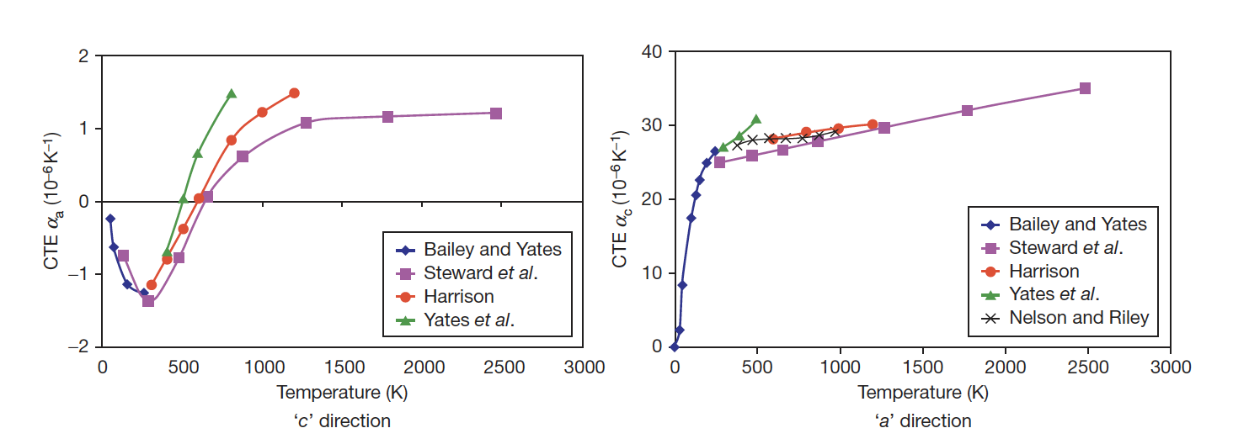
Fundamental Properties
The CTE for graphite displays anisotropic behavior, and strongly varies as a function of temperature
Due to the structure, the strength along the basal planes is higher than the strength perpendicular to the planes, and the shear strength between the basal panes is relatively weak
The thermal conductivity along the basal planes is much greater than perpendicular to the planes

Slide 27
Mrozowski Cracks
During the manufacture of artificial graphite, very high temperatures (2800–3000 C) are required
Upon cooling, the anisotropy in thermal expansion coefficients leads to the formation of long, thin microcracks parallel to the basal planes, often referred to as ‘Mrozowski’ cracks
The presence of these microcracks is very important in understanding the properties of nuclear graphite
These cracks form in both TRISO PyC, sometimes called highly orientated pyrolytic graphite (HOPG), and standard nuclear graphite

Slide 28
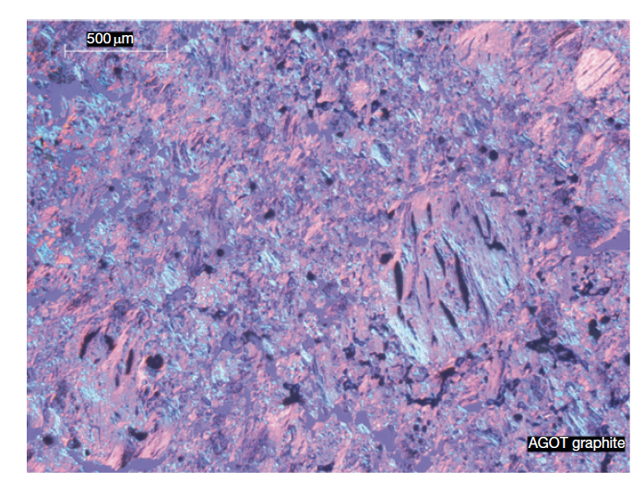
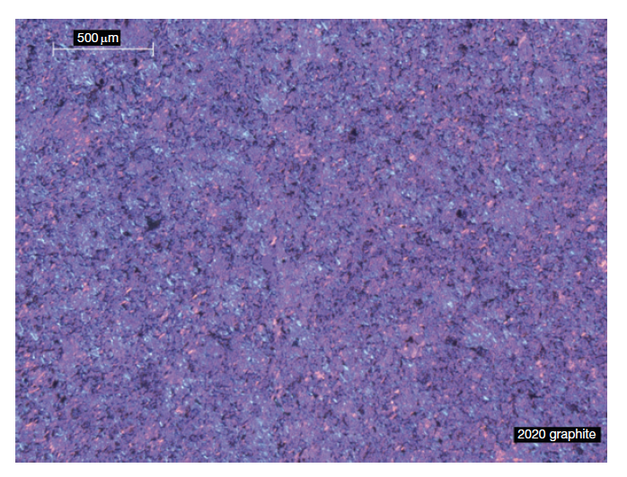
Graphite Texture
Graphite structure is largely dependent upon the manufacturing process
Graphites are classified according to their grain size from coarse-grained (containing grains in the starting mix that are generally >4mm) to microfine-grained (containing grains in the starting mix that are generally <2 μm)
Grade AGOT was used as the moderator in the earliest nuclear reactors in the United States
Nuclear graphite is medium to fine grained, includes grades of Gilsocarbon, IG-110 and IG-11, and many others
Ideally manufacture graphite with bulk isotropic properties; with grain/against grain ratios near 1

Slide 29
Initial Porosity
A dominant feature of graphite texture is the amount of porosity
About half the total porosity is open to the surface
The formation of pores and cracks in the graphite during manufacture adds to the texture arising from grain orientation and causes anisotropy in the graphite physical properties
Three origins of porosity:
Those formed by incomplete filling of voids
Gas entrapment during pyrolysis
Thermal cracks

